Slide 1

Verifying Cyber-Physical Systems
Chapter 1 – 2
Abenezer Taye
Feb 09, 2022

Slide 2
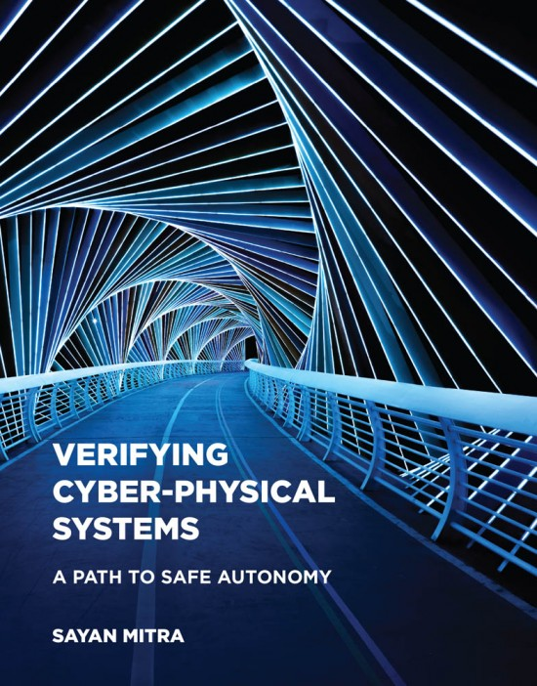
Chapter 1: INTRODUCTION

Slide 3

Introduction
Cyber Physical System (CPS): systems that are controlled by computer
Requirements for CPS: the desired or claimed behaviors of the system (aka specifications or properties)

Slide 4
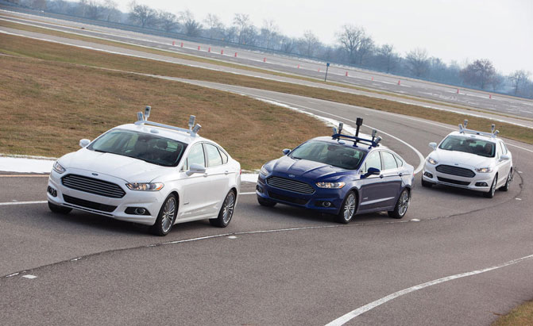
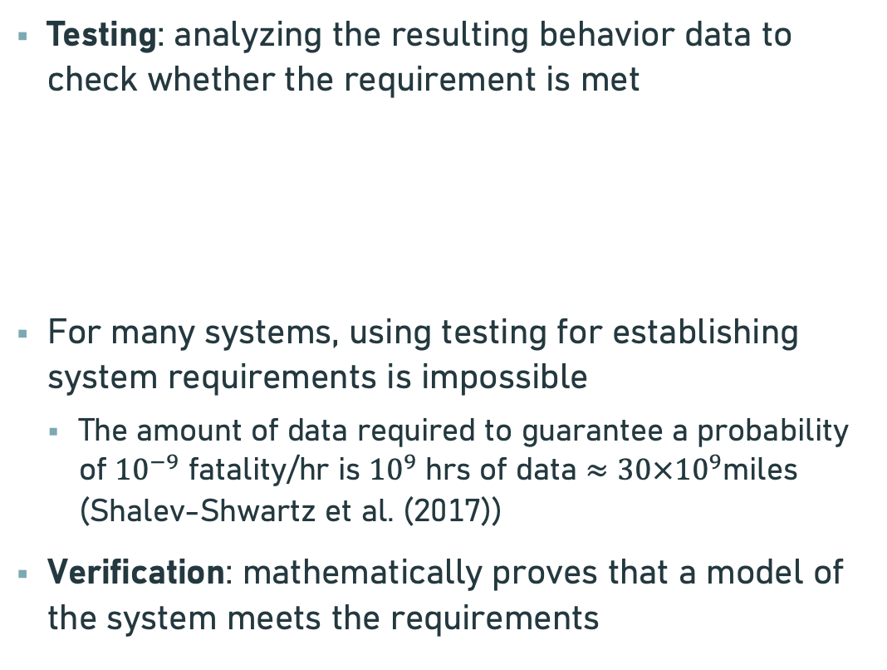
Testing Vs Verification
Testing: analyzing the resulting behavior data to check whether the requirement is met
For many systems, using testing for establishing system requirements is impossible
The amount of data required to guarantee a probability of ${10}^{−9}$ fatality/hr is ${10}^{9}$ hrs of data $≈30×{10}^{9}$miles (Shalev-Shwartz et al. (2017))
Verification: mathematically proves that a model of the system meets the requirements
Initial
condition
System
Output
Input

Slide 5
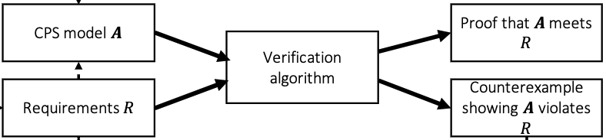
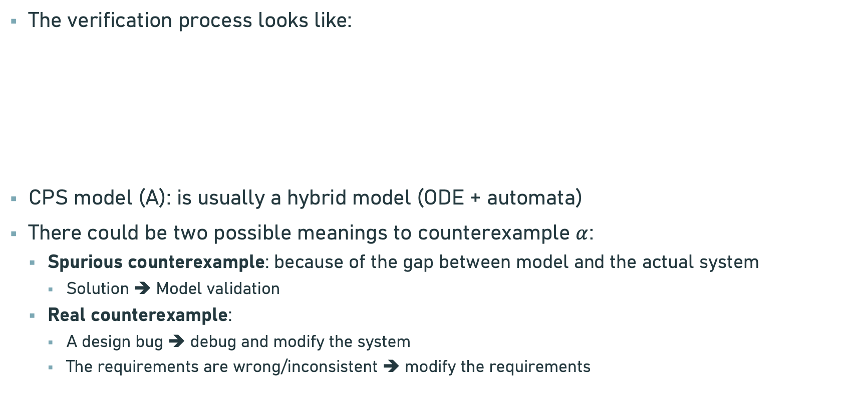
Verification
The verification process looks like:
CPS model (A): is usually a hybrid model (ODE + automata)
There could be two possible meanings to counterexample $α$:
Spurious counterexample: because of the gap between model and the actual system
Solution ➔ Model validation
Real counterexample:
A design bug ➔ debug and modify the system
The requirements are wrong/inconsistent ➔ modify the requirements

Slide 6
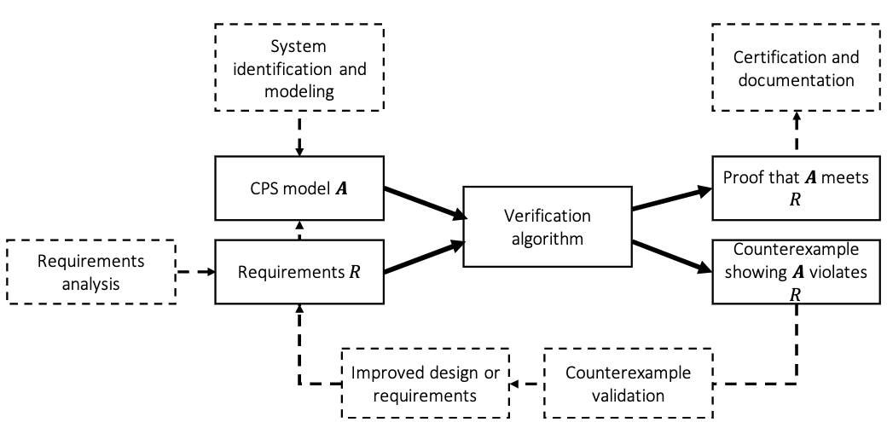
System Design Ecosystem

Slide 7
Challenges of Verification
Theoretical undecidability :
There is no algorithm that checks whether a model of CPS meets a requirement.
To address this → relaxing the verification question (e.g. bounded time horizon or tolerate some false positives)
Practical Scalability :
Lack of scalability is a huge challenge for the progress in verification
Missing Models :
Complete models of CPS systems are difficult to come by
Oftentimes models lack succinct descriptions, are distributed, and are protected intellectual property
Learning-enabled systems and missing requirements :
Recent CPS systems use DNN ➔ lack models and requirements

Slide 8
Chapter 2: MODELING COMPUTATION

Slide 9
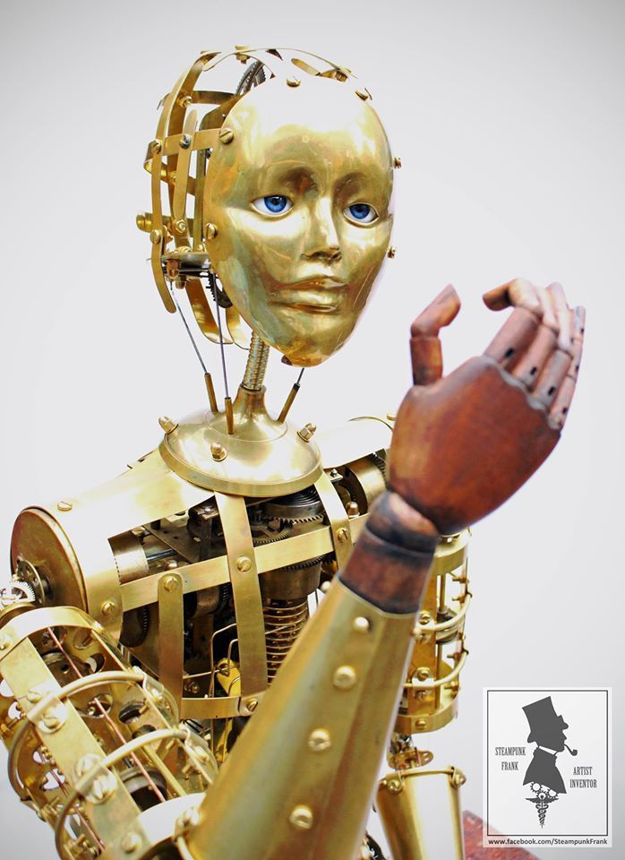
Introduction
Aim: how can we develop a mathematical model for computation
We use differential equations to model physical systems ➔ how about computation?
Automaton: 19th century word used to describe mechanical dolls
In mathematics, we use automaton to describe the rules of state change of any computational process
Aka, discrete-time transition system or a state machine

Slide 10
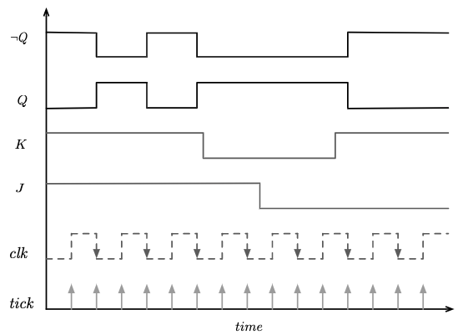
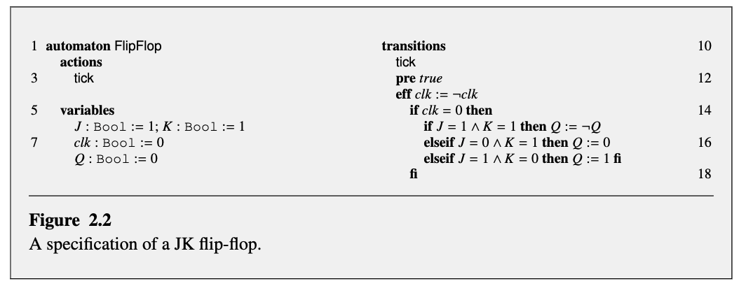
Example: JK Flip-Flop
clk | J | k | Q
0 | 0 | 0 | previous
0 | 0 | 1 | 0
0 | 1 | 0 | 1
0 | 1 | 1 | toggle
Parts of specification
Actions: lists various types of rules for state change
Variables: lists the state variables
Transitions: lists the state change rules for each of the actions

Slide 11


Specifying automata
State variables:
A state represents the information necessary for predicting the future of an automaton
Valuation:
Maps each state variable name to a value
Predicates:
A Boolean–valued formula involving the variables in V (we use it as a requirement)
For example: the state satisfies the formula
Because
Transitions:
Specify the rules for state change in a computation

Slide 12
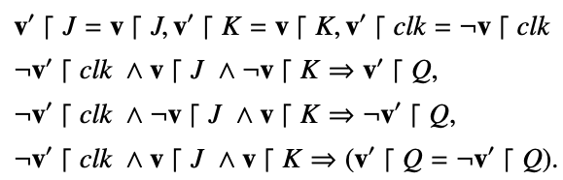

Automata
An automaton $𝓐$ is a tuple $\left(V,Θ,A,𝓓\right)$, where
V is a set of state variables and val(V) is valuations of V
$Θ⊆val(C)$ is a set of start states
A is a set of actions
$𝒟⊆val(V)×A×val(V)$ is called the set of transitions

Slide 13
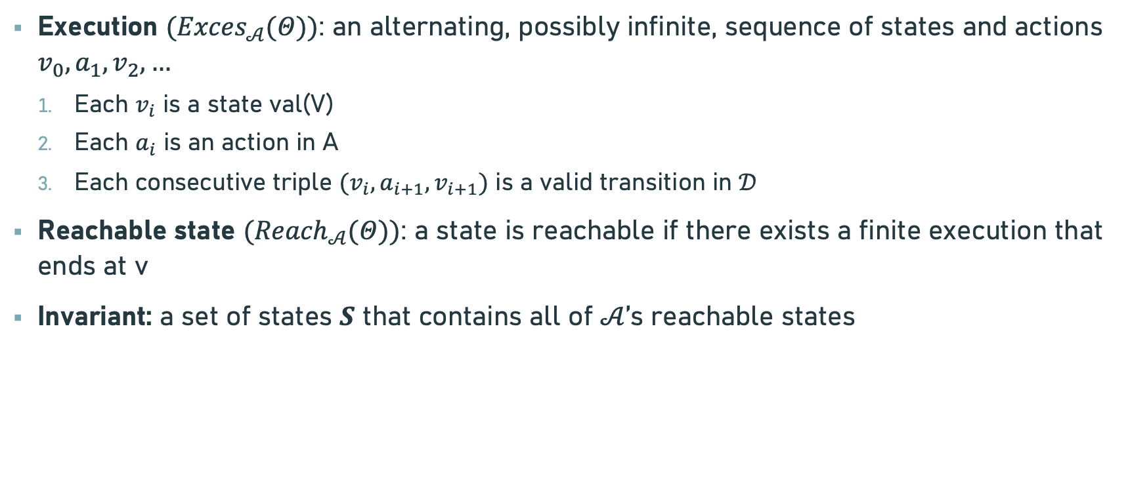
Semantics
Execution $({Exces}_{𝒜}(Θ))$: an alternating, possibly infinite, sequence of states and actions $v_{0}, a_{1}, v_{2},…$
Each $v_{i}$ is a state val(V)
Each $a_{i}$ is an action in A
Each consecutive triple $(v_{i}, a_{i+1}, v_{i+1})$ is a valid transition in $𝒟$
Reachable state $({Reach}_{𝒜}(Θ))$: a state is reachable if there exists a finite execution that ends at v
Invariant: a set of states $S$ that contains all of $𝒜$’s reachable states

Slide 14
Thank You!!!

